Slide 1
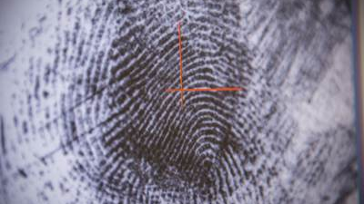
Emotion Recognition

Slide 2


What and Why ?

Slide 3
The development of sensor networks, the Internet of Things (IoT) technology, and wearable smart devices it can now be possible to detect different human emotions quickly and efficiently.
Emotion recognition plays a crucial part in human health and the related medical procedure to detect, analyze, and determine the medical conditions of a person.
Recent market studies show that there is a huge demand for human emotion recognition systems. It is predicted that the global emotion detection and recognition market size would be USD 56.0 billion by 2024, compared to USD 21.6 billion in 2019.
Law enforcement, entertainment, and surveillance and monitoring.

Slide 4
Contributions
Emotion recognition in Augmented Reality (AR).
Emotion recognition on Artificial Intelligence (AI).
→ Review the state-of-the-art development of devices and technologies for human emotion recognition of technology, design, methods, and applications.

Slide 5
Human Emotion Recognition
Human emotion based on facial expressions
Human emotions based on brain wave signals
Human emotions based on speech
Human emotions based on signal from wearable devices

Slide 6
Model
Ctnet
Deep Learning
End-to-End Multimodal Emotion Recognitionusing Deep Neural Networks

Slide 7
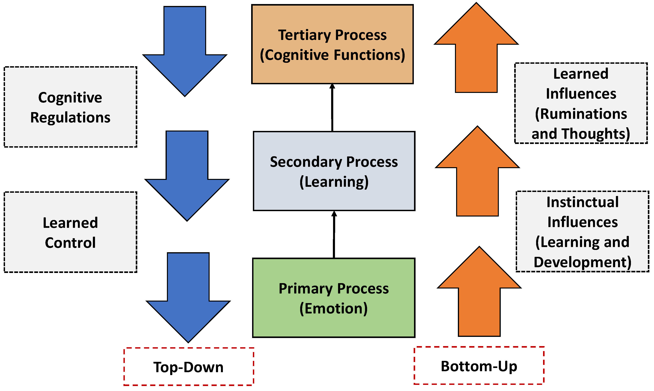
Devices for Human Emotion Recognition
In the first process emotions are collected by sensors.
In the second process, appropriate learning technology (and memory) is used for the collected data.
Finally, in the last process, appropriate decisions are taken based on the higher cognitive functions

Slide 8
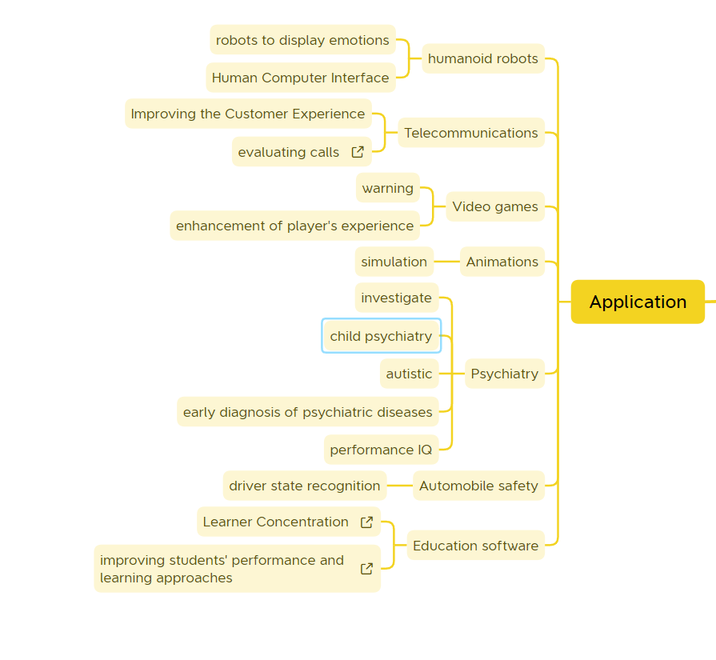
Design Challenges and Applications

Slide 9
Current Trends and Future Directions

